Slide 1
Combating Anti-Asian Sentiment in COVID-19,
Path to Recovery
2021 Aggie Hacks x Google Cloud: COVID19 Challenge, Path to Recovery
Presented by Random Jungle

Slide 2



Executive Summary
Context
Analysis
Conclusion
Twitter Data
Sentiment Analysis
Categorize COVID & asian community related topics into positive and negative comments
KOLs’ views shape the crowds’ sentiments
Key Opinion Leaders (KOL) associating COVID with the Asians will stimulate hate speech, putting the community on threats
COVID Related Tweets
Topic Modeling
Design modeling function - a Latent Dirichlet Allocation (LDA) Model
Speak up and show support, your voice matter
The #StopAsianHate campaign on social media successfully raised awareness of anti-racism
2020.2 - 2021.3
key events:
Trump’s “China Virus” tweet, Atlanta Mass Shooting
#StopAsianHate
Notes:
Our project scraped tweets that included keywords associated with Asian and COVID-19 to analyze whether Key Opinion Leaders’ opinions towards the Asian community on social media has an impact on the sentiment of crowds.
We used Natural Language Processing techniques such as sentiment analysis and topic modeling to conduct the analysis.
In the end, we concluded that Key Opinion Leaders’ views shaped the crowds’ sentiments, and as individuals, speaking up and showing support towards the Asian community do make a lot of differences.

Slide 3
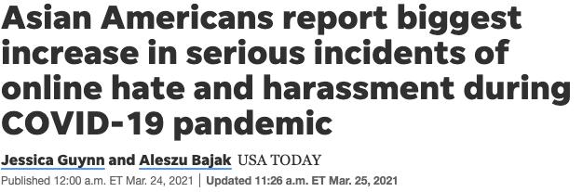
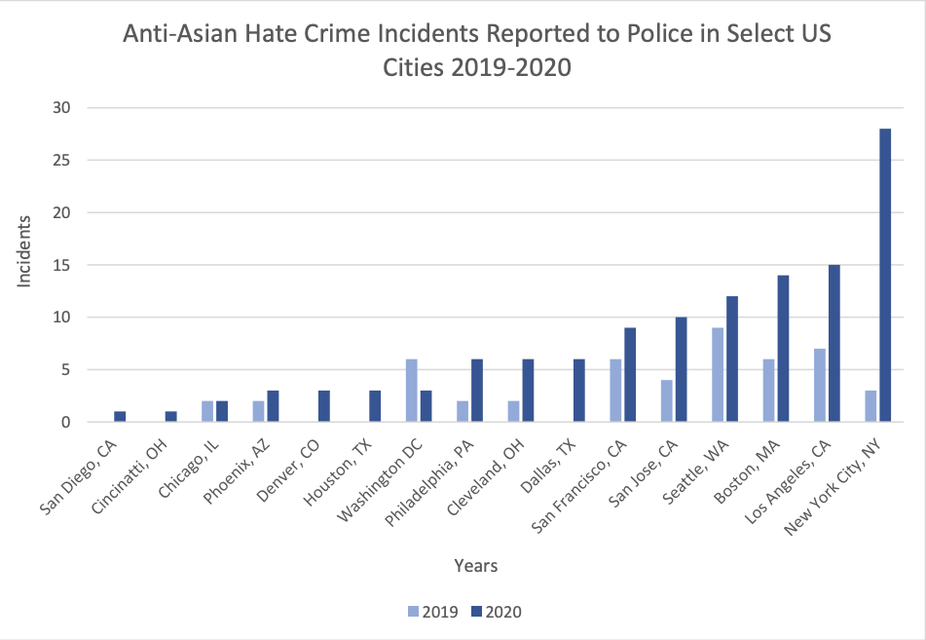
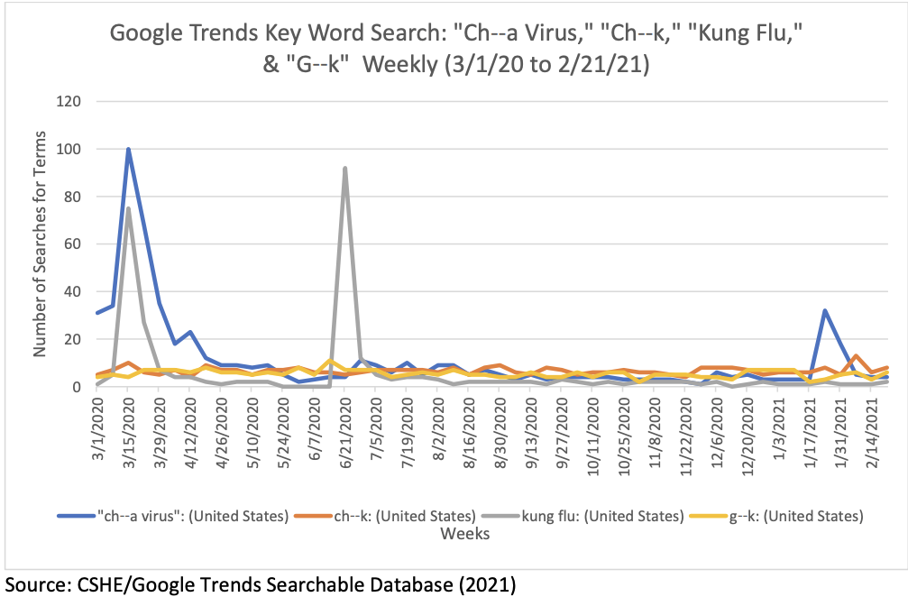
Anti-Asian hate crimes rose by 149% in 2020 while overall hate crimes dropped by 7%.
Data Source: Center for Study of Hate & Extremism published a report
Notes:
According to a report published by Center for Study of Hate & Extremism, anti-Asian hate crime surged 149% in 2020 while overall hate crimes dropped by 7%. In addition, many medias such as US Today are reporting the increase in cases of Asian American hate and harassment during the COVID-19 pandemic.
After reading these unfortunate news, we started wondering where all these hate speech and crime spreaded from. Further research indicates that social medias have become major places where people express their feelings. Further, key opinion leader like Donald Trump, the former president of the United States, named COVID-19 as “Chinese Virus” on Twitter and blamed the Asian community for the spread of COVID-19.
Although there are people opposed his opinion, stating it as “racism”, this tweet has triggered a wave of Asian hate in the US, as seen in news. Therefore, we want to further investigate how key opinion leaders shape the crowds’ opinion on social media.

Slide 4

How do Key Opinion Leaders’ tweets about the Asian community impact the anti-Asian sentiment of crowds?
Notes:
Therefore, we wanted to analyze the question “How Key Opinion Leaders’ opinions towards the Asian community on social media impact the sentiment of crowds?”

Slide 5

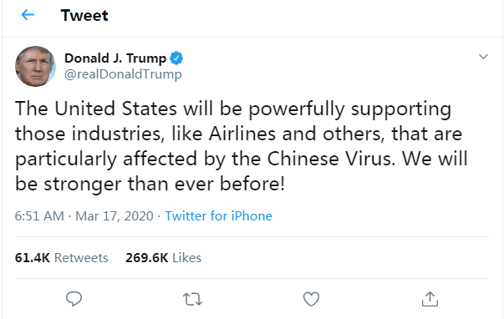

Major events happened to the Asian Community during the pandemic...
Notes:
We wanted to focus on the two time periods related to the Asian Community during the pandemic.
The first time frame is when the former president of the United States, Donald Trump, used the phrase “Chinese Virus”, and the second time frame is when the Atlanta Shooting happened and the Stop Asian Hate movement began. During this time, many Key Opinion Leaders such as the famous singer Rihanna and leaders in the tech industry such the CEO of Google spoke to support the Asian Community.
Since hate and anti-Asian is a negative sentiment, we decided to focus on the tweets that had negative sentiments.

Slide 6
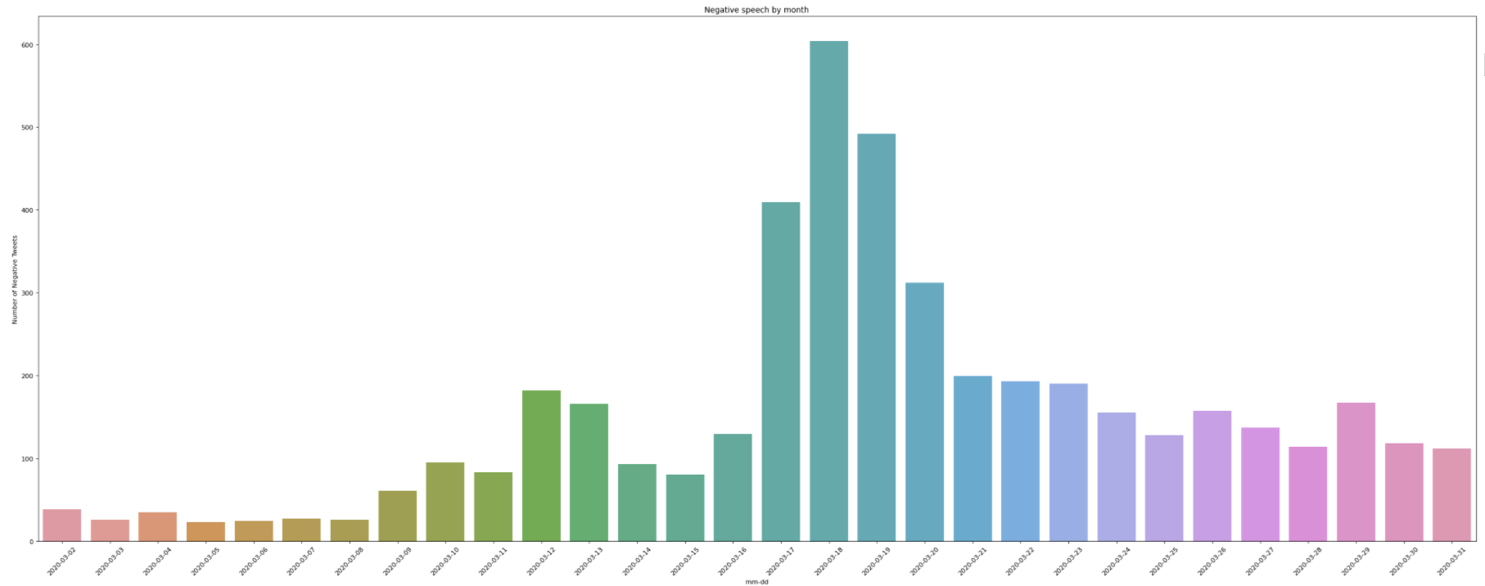
What happened after Trump tweeted “Chinese Virus”?
Negative Speech by Month
Number of Negative Tweets
200
3/17/2020
Notes:
The first time Trump mentioned “Chinese Virus” on Twitter was on March 16, 2020. So we scraped the tweets to observe the trends. These are all tweets that mentioned Asian and COVID-related keywords from March 2rd, 2020 to March 31st, 2020, which were two weeks before and after the event happened.
As shown in the graph, right after Trump tweeted “Chinese Virus”, there was a surge in negative-sentiment tweets as highlighted. Although the count decreased afterwards, it still remained at a high level compared to before the event happened. This shows that his tweet did increase the negative sentiment related to discussions around Asians and the pandemic.

Slide 7
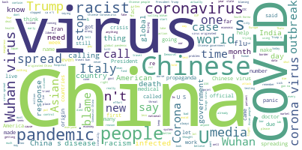
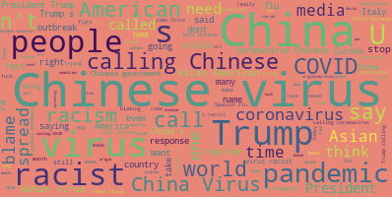
People started associating “Chinese” with “Virus”.
03/02/2020 - 03/16/2020
2 weeks before Trump’s first tweet on ‘Chinese Virus’
03/17/2020 - 03/21/2020
After Trump's first tweet on ‘Chinese Virus’
Notes:
Further, we created word clouds to compare the frequency of words mentioned in the negative tweets before the event and during the peak of the event. We could see that people started associating Chinese and Virus together and using the phrase “Chinese virus” more often. On the other hand, the word “racist” is mentioned often as well, people were having intense and aggressive discussions around the topic of calling COVID-19 the “Chinese Virus.”

Slide 8

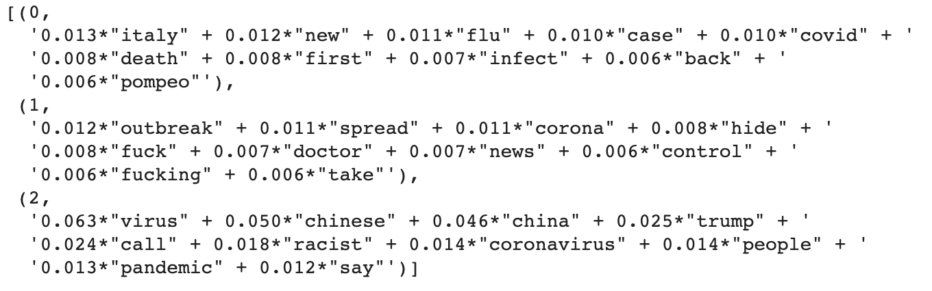

When people talk about Asian, they are talking about...
“The increase of COVID cases and death in Italy is all related to this virus from China.”
“I hate that the Coronavirus is out of control. Why the doctor don’t do something? Why the Asians are hiding the cases?”
Notes:
Further, we analyzed common topics among the negative-sentiment tweets related to asian and COVID to find the top 2 topics that people express negative feelings towards.
We found that:
People associate Italy, one of the countries that suffers the most coronavirus cases with China and the Asian Community.
People express anger towards the spread of corona cases which went out of control, and seems to blame Asian communities

Slide 9
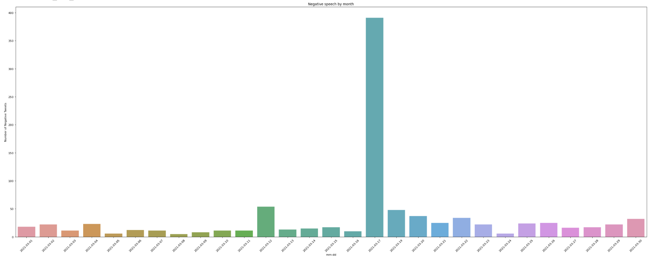
What happened when #StopAsianHate started?
Negative Speech by Month
Number of Negative Tweets
3/16/2021
Notes:
Looking at the second time period, what happened when the shooting in Atlanta caused the surge in the Stop Asian Hate movement?
We scraped tweets two weeks before and after the event data of March 6, 2021 to observe the trend.
The day after the shooting happened, the count of negative tweets drastically increased for this day, but this trend did not continue. It seems like with the anti-racism movement, people are acting more peacefully on the internet. So, were the negative sentiment tweets towards the Asian community?

Slide 10
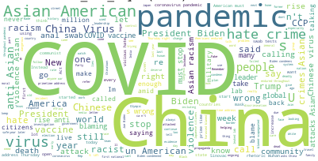
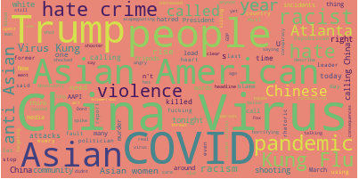
Increased awareness of anti-racism and hate crime.
03/01/2021 - 03/15/2021
2 Weeks before Atlanta Anti-Asian Mass Shooting
03/16/2021 - 03/17/2021
Around Atlanta Anti-Asian Mass Shootings
Notes:
From the word cloud, the words like “Asian American” and “hate crime” were mentioned much more often during the peak. Since these words did not seem like anti-Asian words in general, we think topic modeling could help us with a better understanding.

Slide 11

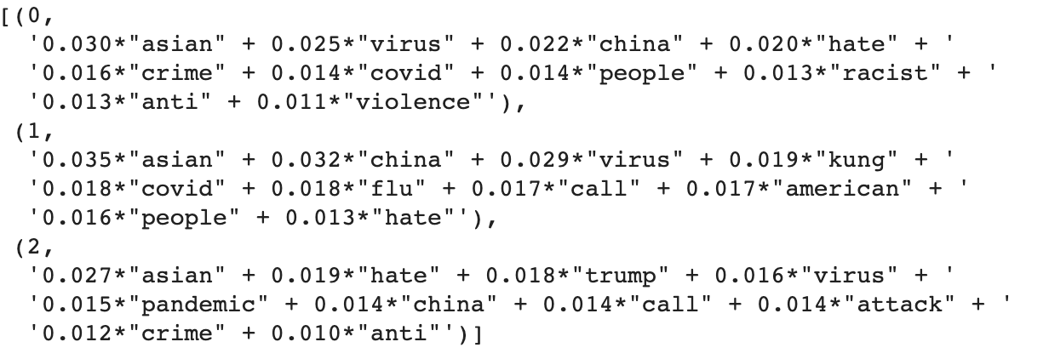

When people talk about Asian, they are talking about...
“ The Asian community suffers from the virus as well! Hate will only lead to crime! Stop being a racist, it will only lead to more violence.”
“I am so sick of this China Virus thing. Stop calling Covid ‘kung flu’, this is hate speech, people!
Notes:
We also did a topic modeling to identify the top 2 topics in the negative-sentiments tweets related to Asian and COVID after the #StopAsianHate campaign.
We found that:
People are serious about supporting anti-racism campaign, and are aware of how hate speech would trigger violence.
People are disgusted about the racial words posts against the Asian community.
We are glad to find that the #StopAsianHate movement has raised awareness of protesting hate speech and building a more inclusive society

Slide 12
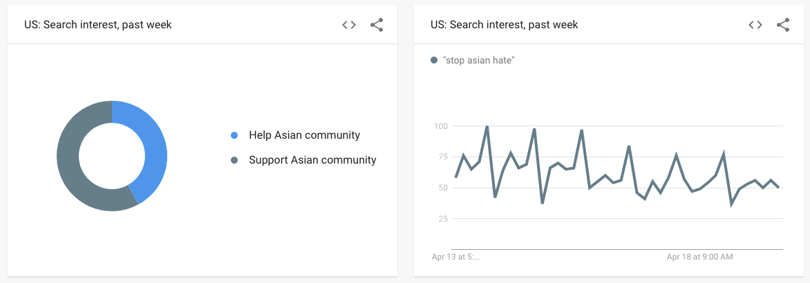
After #StopAsianHate, people are searching for ways to help and support the Asian community.
Source: https://trends.google.com/trends/?geo=US
Notes:
Apart from social media like Twitter, we observed a general trend of people’s interest in helping & supporting the Asian community after the #StopAsianHate campaign. It indicates a success in raising awareness in anti-racism effort for the Asian community.

Slide 13
Conclusion
KOLs’ views shape the Crowds’ sentiment
Speak up and show support, your Voice matter
Leaders should always consider the impact he/she will bring, and be aware that hate is contagious. Once triggered, it would bring violence to the society.
#StopAsianHate campaign has successfully raised the awareness of Asian racial justice and the call for a more inclusive community
Notes:
In conclusion, Leaders should always consider the impact he/she will bring, and be aware that hate is contagious. Once triggered, it would bring violence to the society. As individuals, please speak up and show support, your voice really matter.
Together, we will make it through the pandemic and build a more inclusive society!

